Slide 1
Error Correcting Codes for High Altitude Balloons
Matthew Brejza
The author acknowledges the use of the IRIDIS High Performance Computing Facility, and associated support services at the University of Southampton, in the completion of this work

Slide 2
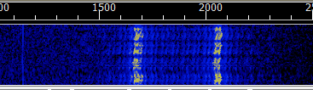
Why Error Correction Codes are Needed?
Reducing transmitted power
Maintain reliable communication in unfavourable conditions
Bursts of interference
Fading signal
Low SNR
Increase throughput

Slide 3
Some Error Correcting Codes
Block
BCH (1960)
Reed Solomon (1960) CDs/DVDs, DVB-T
LDPC (1963, 1996) DVB-S2
Convolutional
Viterbi decoded (1967) DVB-T, deep space
BCJR decoded (1974)
Turbo (1993) LTE

Slide 4
A Very Basic Code
01101
000 111 111 000 111
+
010 110 111 011 011
01111
noise
Repetition code
1/3 rate code
Performance: bad

Slide 5
An Improvement
channel
0 1 1 0 1
0 1 1 0 1
0 1 1 0 1
-2 | 3 | 1 | -5 | -1
2 | 4 | 5 | 2 | 3
-3 | -2 | 2 | 1 | 2
01101
+
Demod
-3 5 8 -2 4
0 1 1 0 1
noise
Soft information conveys probabilities for each bit
Usually expressed in the log domain, numbers have much smaller dynamic range
Known as Log Likelihood Ratio (LLR)

Slide 6
Reed Solomon (RS) Code
Developed in 1960s
Block Code
Non-binary
Adds t parity symbols, can correct up to t/2 symbol errors
Examples
RS(7,3) – R=0.43, symbol = 3 bits, 4 parity symbols
RS(255,223) – R=0.87, symbol = 8 bits, 32 parity symbols

Slide 7
Bit Error Rate (BER) Plot
AWGN channel, BPSK modulation

Slide 8
E_{b}/N₀ vs. SNR
SNR provides unfair comparison between codes of different rates
E_{b}/N₀ – ‘SNR per data bit’
E_{b}/N₀ = SNR – 10log₁₀(R)
Two schemes at the same E_{b}/N₀ use the same energy to transmit a sequence
Takes into account extra bits that need to be sent
Either extra bits take more bandwidth
Extra bits are added on at the end – take more time

Slide 9
BER - E_{b}/N₀ Plot
AWGN channel, BPSK modulation

Slide 10
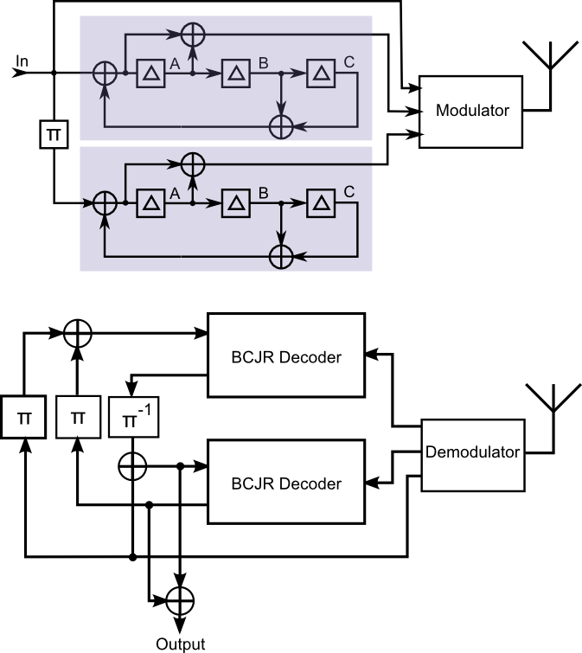
Turbo Code
Combines two convolutional codes
1/3 rate code (min)
Puncture the output to get desired rate
Uses soft information
Uses iterative decoding

Slide 11
BER for Turbo Code, Varying Iterations
AWGN channel, BPSK modulation, message length = 992

Slide 12
BER - Eb/N0 Plot
Turbo Rate ∈ {⅓, 0.5,0.6,0.7,0.8,0.9}
AWGN channel, BPSK modulation, message length = 6144

Slide 13
Frame Error Rate (FER)
AWGN, BPSK, message length = 992 (turbo & RS(7,3)); 1784 (RS(255,223))

Slide 14
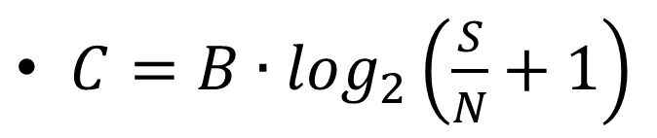
Capacity
Theoretical max throughput for given SNR
Graph shows capacity limit for FER = 10⁻²
$C=B∙\log_{2}\left(\frac{S}{N}+1\right)$
AWGN, BPSK, FER=10⁻²

Slide 15
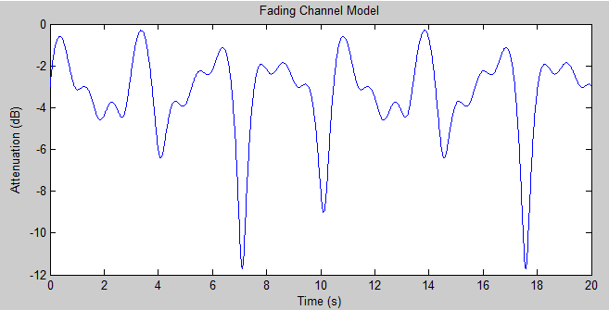
A Fading Channel
Often swinging or falling payloads produce time fading signals
Simple model produced to test performance in a fading channel

Slide 16
FER - fading
Fading channel, BPSK, message length = 992 (turbo & RS(7,3)); 1784 (RS(255,223))

Slide 17
Capacity (Fading)
fading, BPSK, FER=10⁻²

Slide 18
Modulation Schemes – BPSK, (M)FSK
AWGN

Slide 19
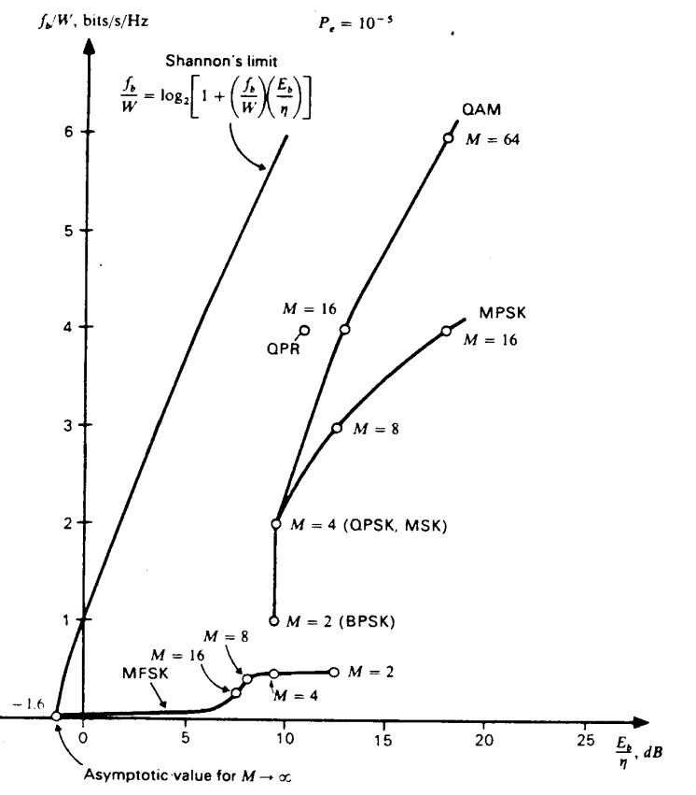
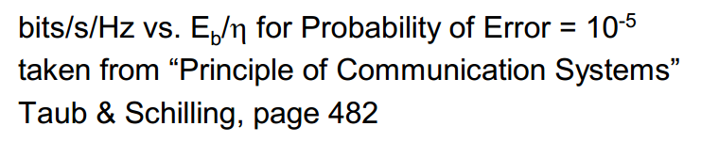
Capacity - BPSK, FSK and MFSK
Frequency shift schemes (FSK/MFSK)
Power efficient
bandwidth inefficient
Phase/Amplitude shift schemes (BPSK,QAM)
Power inefficient
Bandwidth efficient

Slide 20
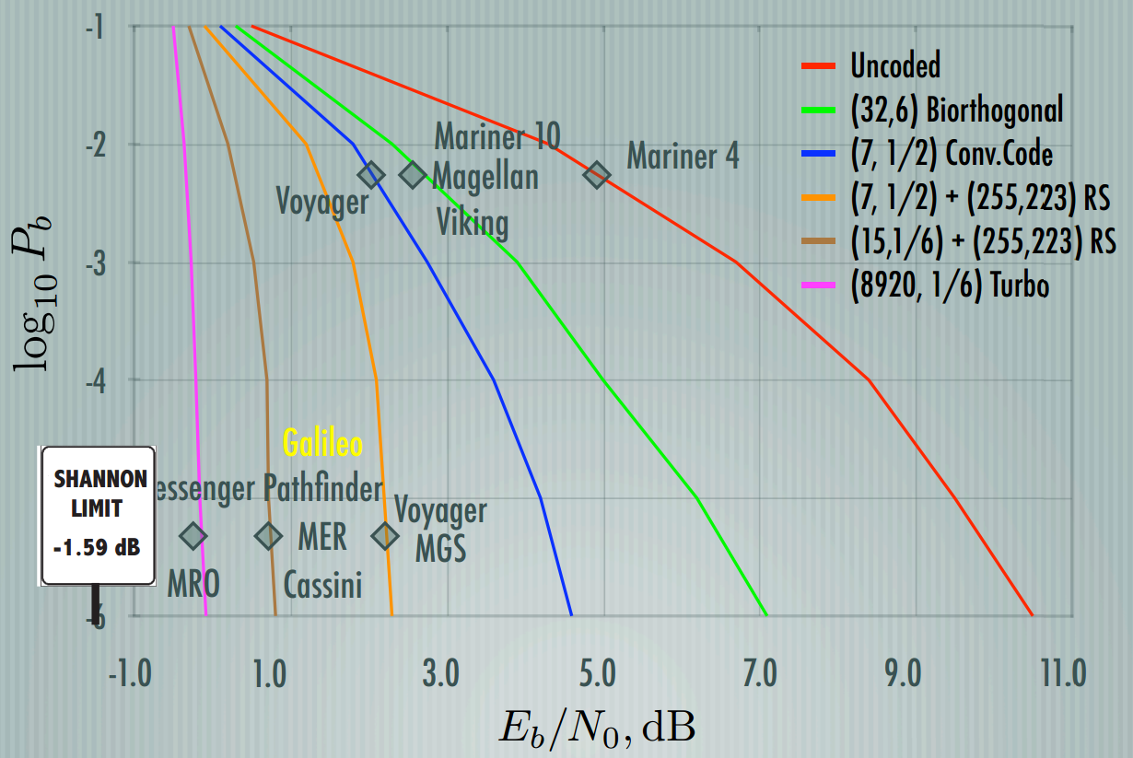
Deep Space Code Usage
http://www.ee.caltech.edu/EE/Faculty/rjm/papers/Viterbi70.pdf

Slide 21
Potential New Telemetry String
Parity 1
Parity 2
Parity 3
Parity 4
Sync + callsign
Length + packet info
GPS
Other telemetry
Checksum
Sync
Sync + callsign
(next packet)
Send as many as needed
Turbo code – R ∈ {⅓, ⅖, ½, ⅔, 1}
Parity bits interleaved and split into four groups
Send as many as needed depending on stage of flight
Ideally keep the same length (of the data part) throughout flight

Slide 22
Concluding Remarks
Can vary coding rate depending on conditions
Coding gain allows lower output power, or higher throughput
Improves reliability in challenging conditions (potentially 22dB gain)
Encoder complexity is low

Slide 23
Questions?
What goes ‘pieces of 7, pieces of 7’?
A parity error

